Slide 1
Postman gives you superpowers
These slides show you how to use them

Slide 2
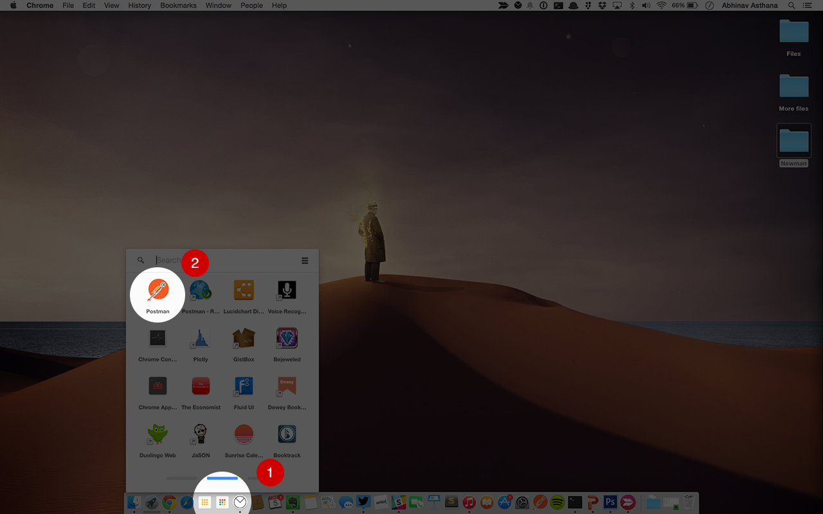
Launch Postman quickly
Chrome’s app launcher sits in your OS dock and let’s you access Postman without opening Chrome.

Slide 3
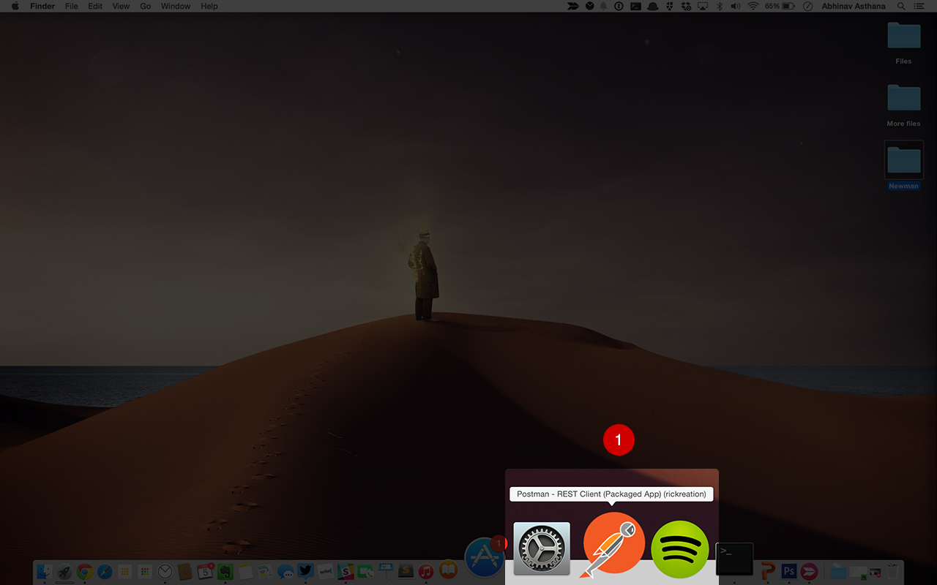
Launch Postman quickly
Create a Postman shortcut just like shortcuts for native apps

Slide 4
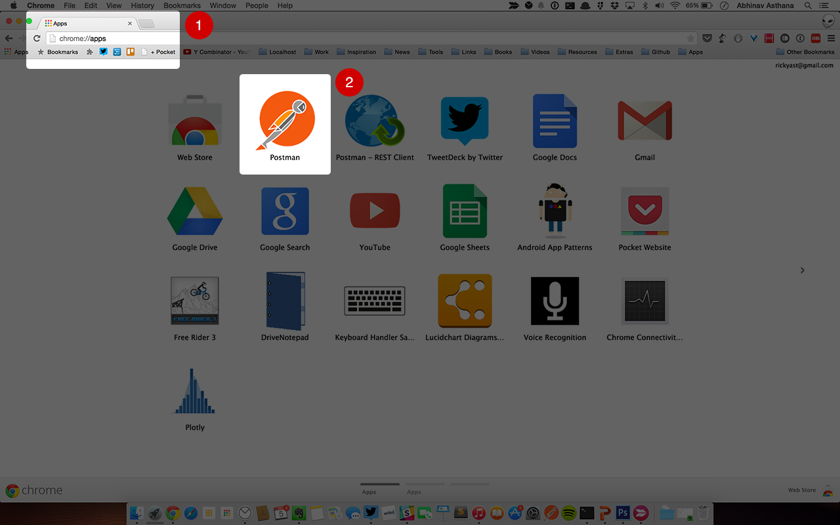
Launch Postman quickly
Go to the “Apps” page using the Bookmarks bar or type chrome://apps in the address bar

Slide 5
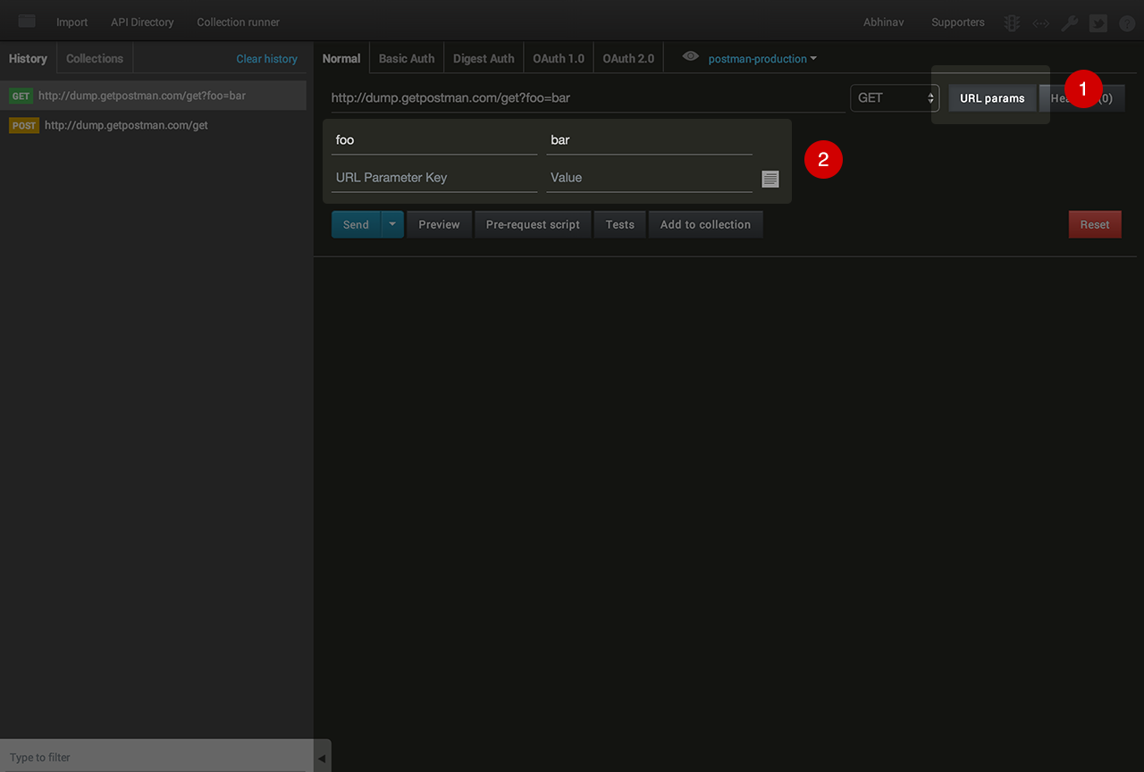
Build requests quickly
URL parameters let you add key-value pairs to construct the request URL quickly.

Slide 6
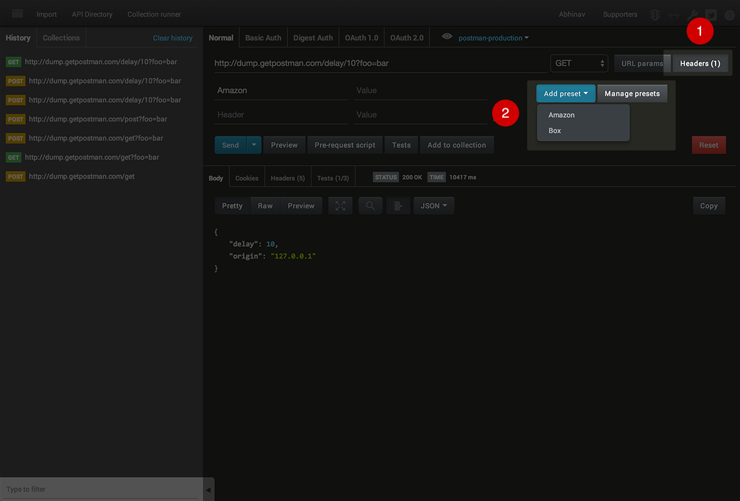
Build requests quickly
Use header presets to save and load common sets of headers.

Slide 7
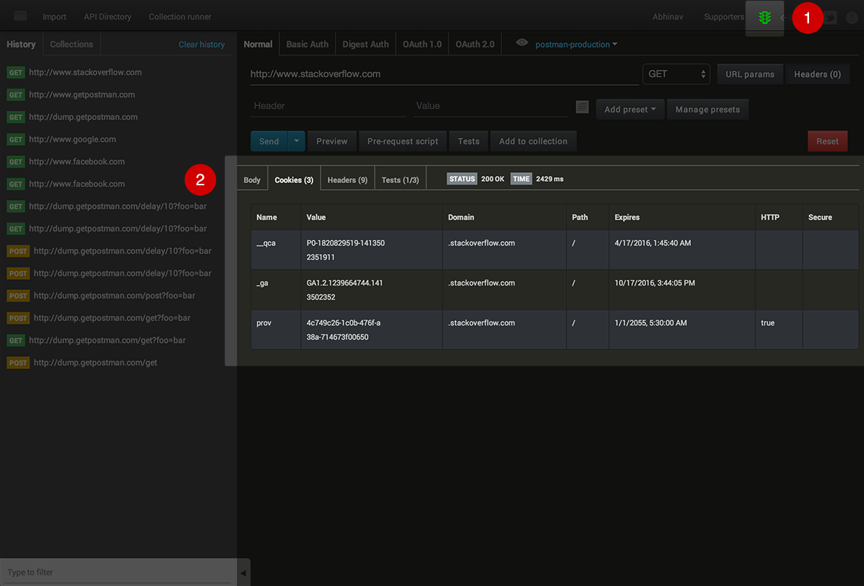
Build requests quickly
Send browser cookies automatically through the Postman Interceptor extension. Install Interceptor

Slide 8
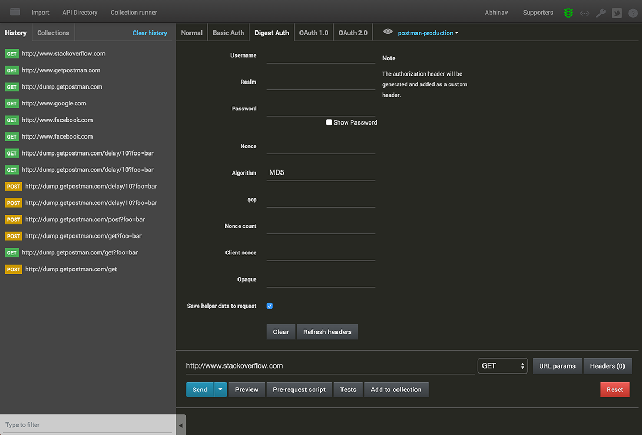
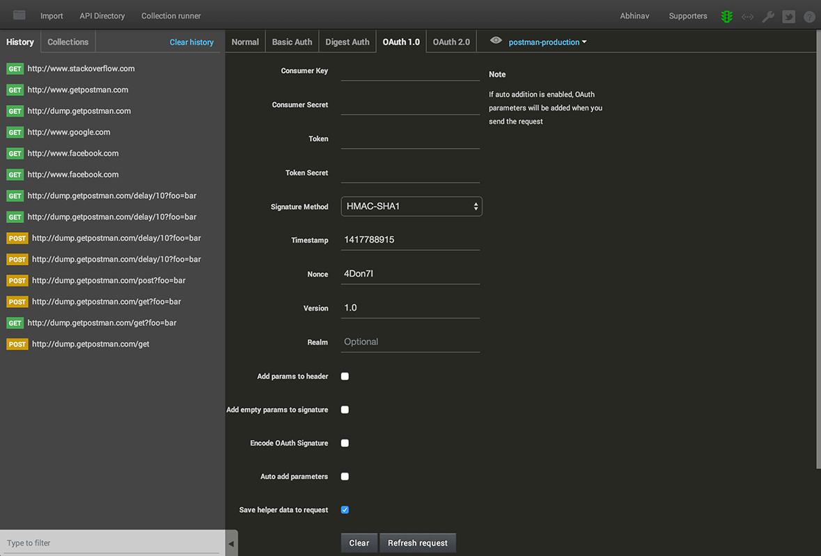
Build requests quickly
Authenticate using Basic Auth, Digest Auth, Oauth 1.0 and Oauth 2.0 helpers. Postman can sign requests and generate header and parameter values.

Slide 9
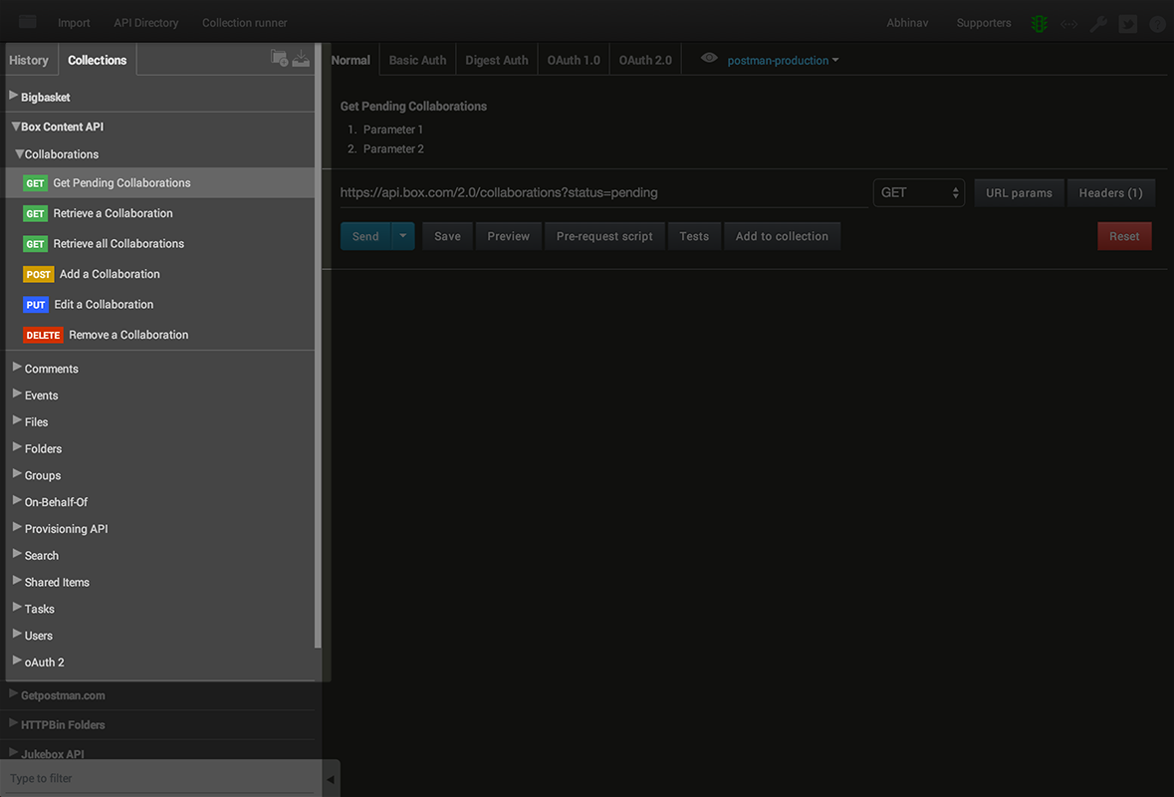
Organize using collections
Collections let you bunch requests together and organize them further in folders. You can use collections for API documentation, user scenarios or any kind of related requests.

Slide 10
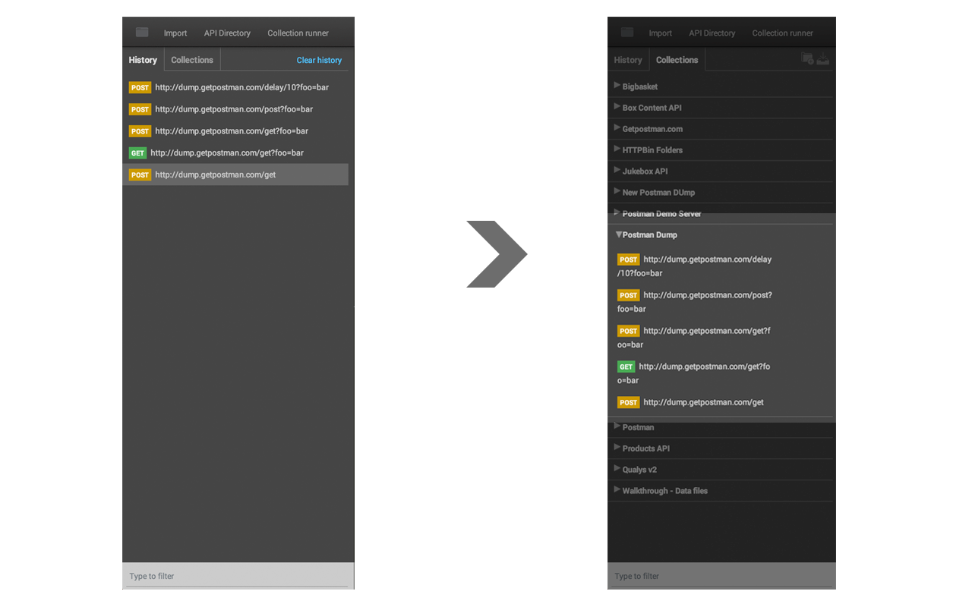
Organize using collections
Using the history to replay requests a lot? Use collections to be more organized.

Slide 11
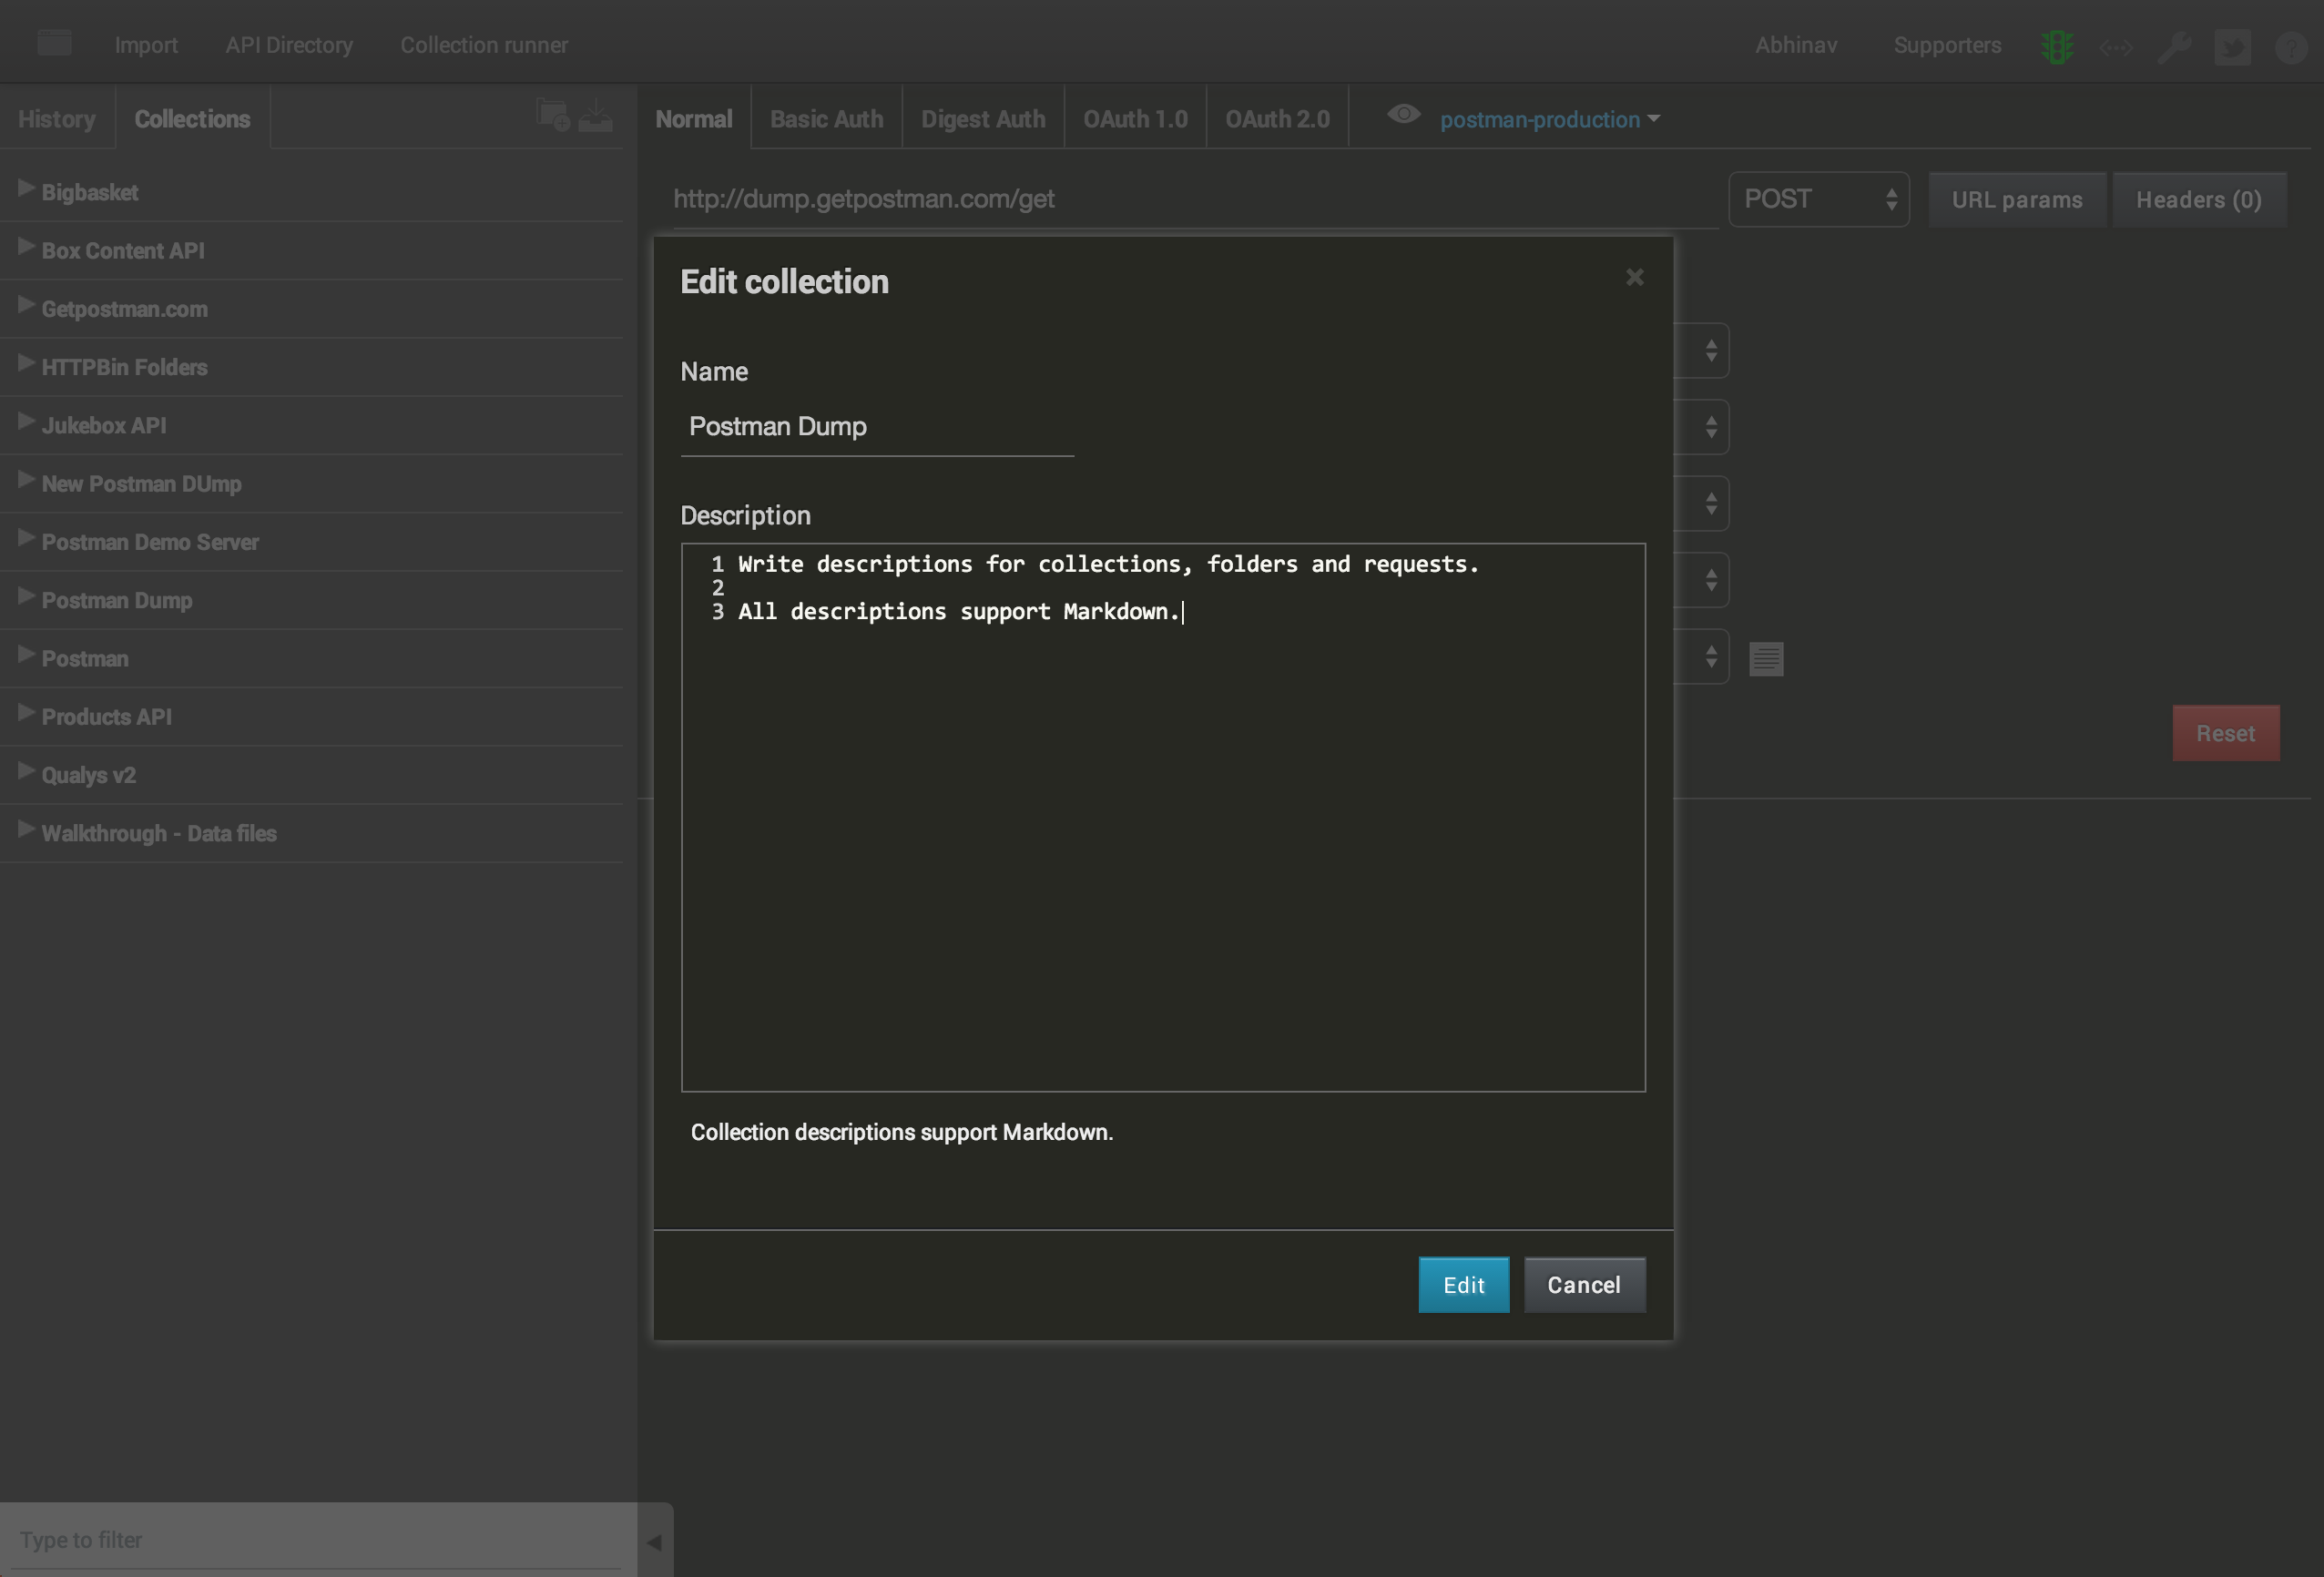
Organize using collections
Document your API using collections.

Slide 12
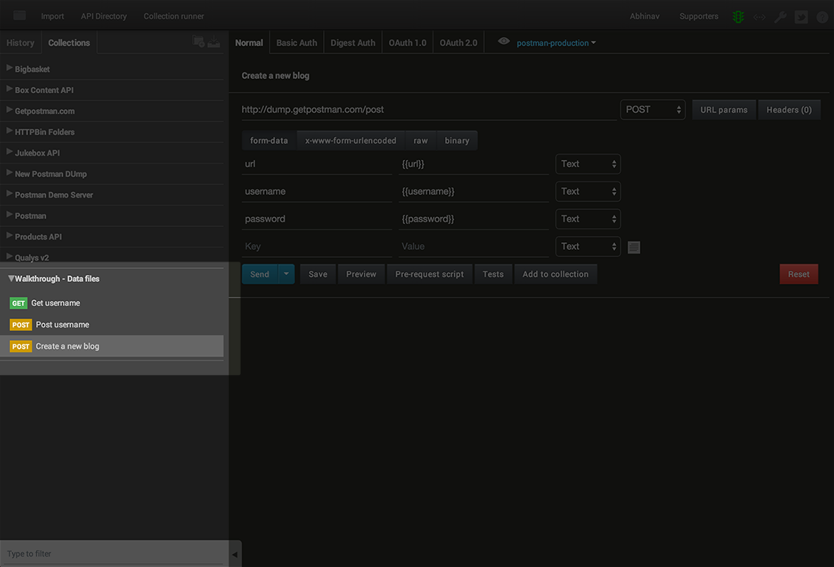
Organize using collections
Store a sample flow using collections.

Slide 13
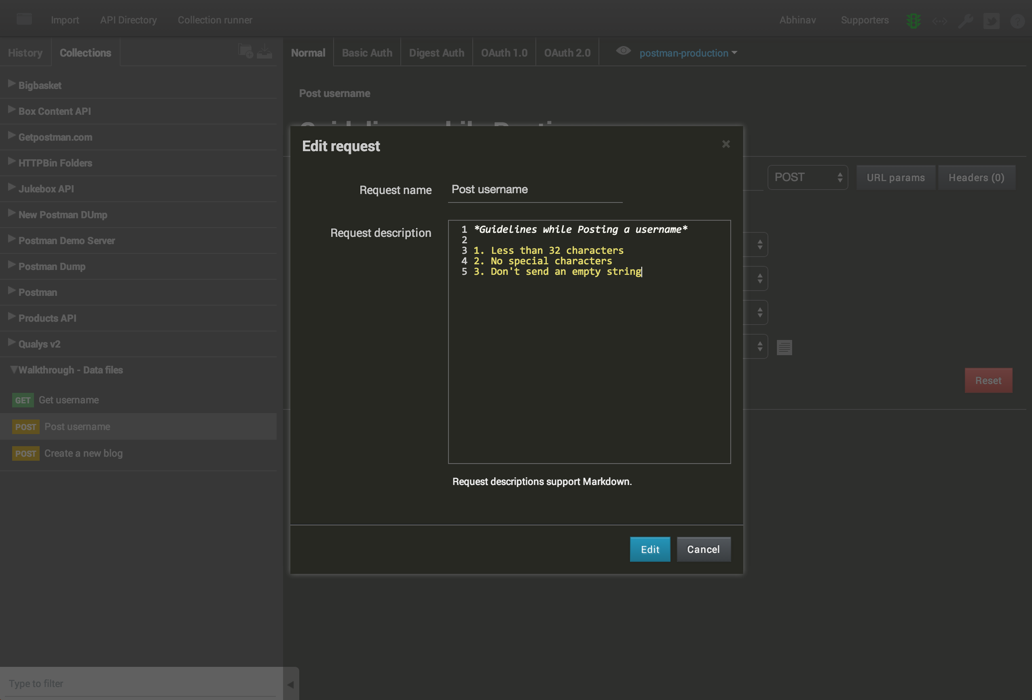
Organize using collections
Add names and descriptions while saving requests in a collection. Descriptions in Postman support Markdown.

Slide 14
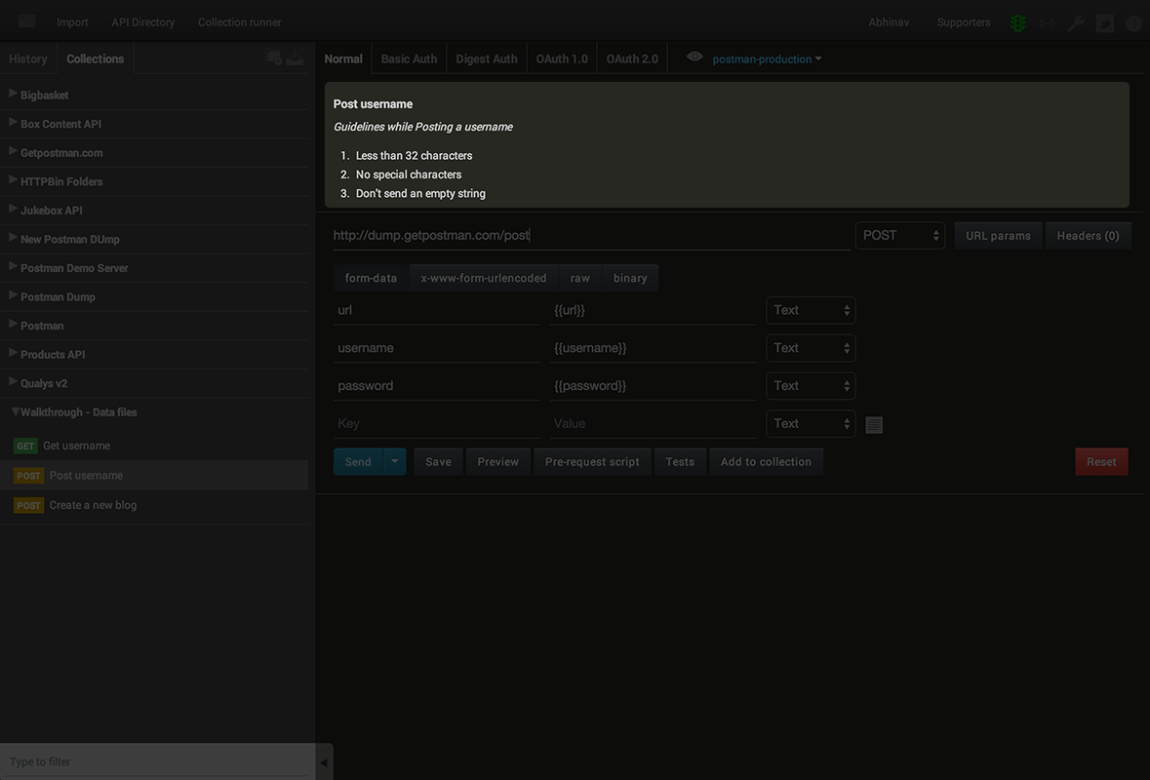
Organize using collections
Descriptions show up right above the request construction module.

Slide 15
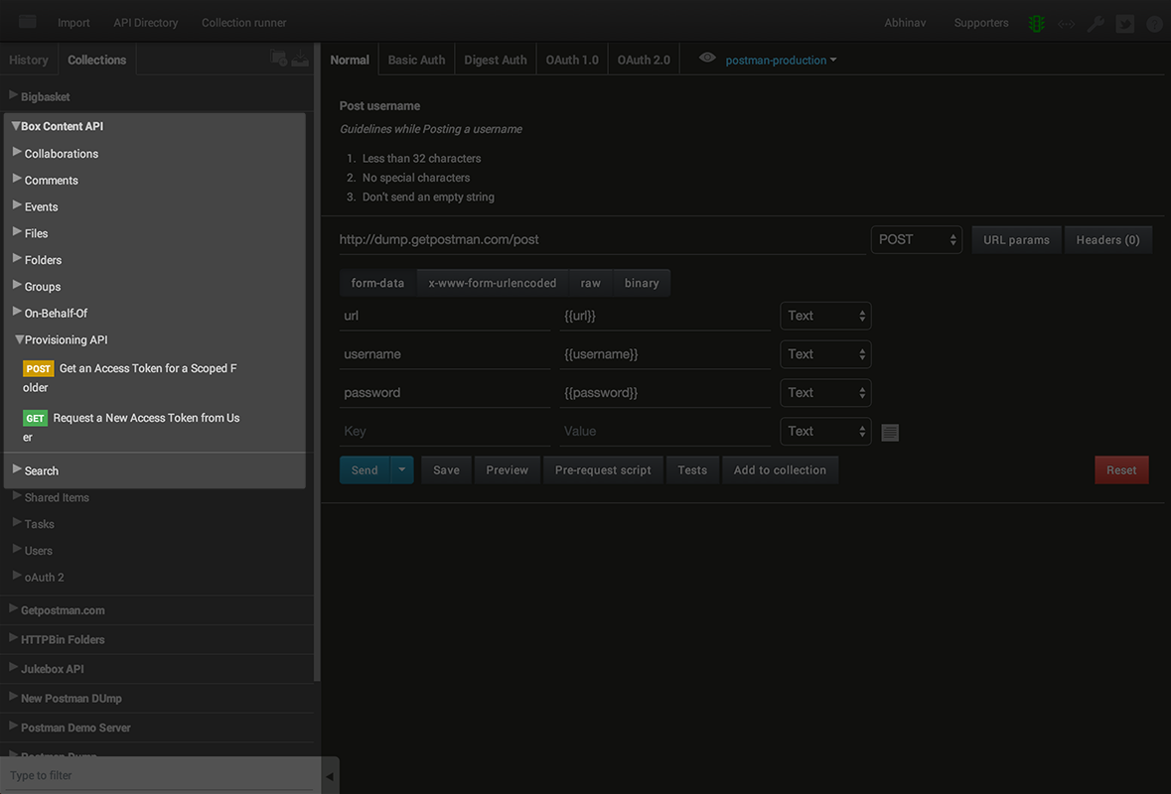
Organize using collections
Lots of requests in a collection? Use folders to organize stuff further.

Slide 16
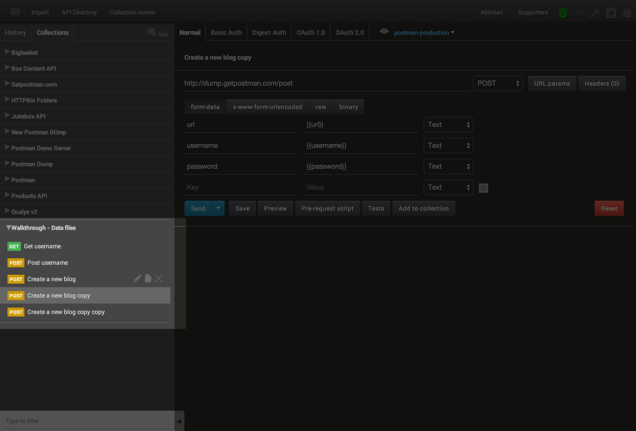
Using collections
Requests can be re-ordered and duplicated inside a collection or a folder.

Slide 17
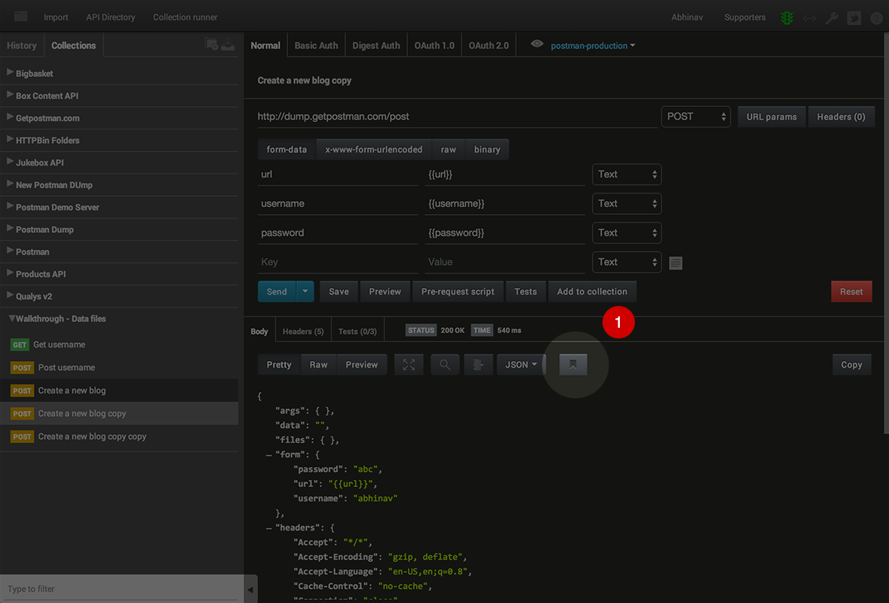
Organize using collections
Save sample responses inside requests. Click on the bookmark icon above the response view.

Slide 18
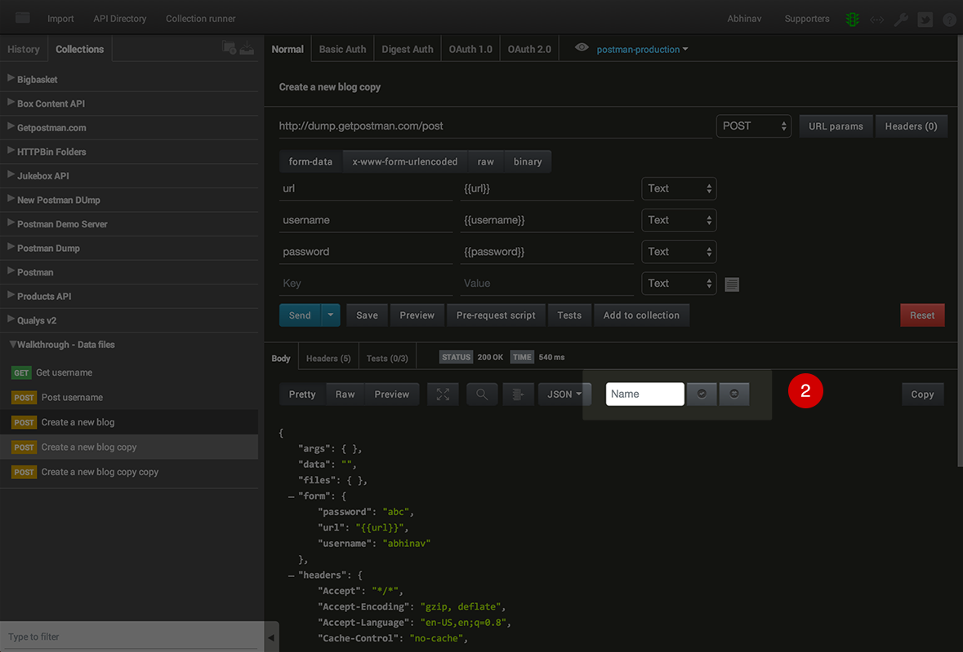
Organize using collections
Saving responses: Give the response an identifier.

Slide 19
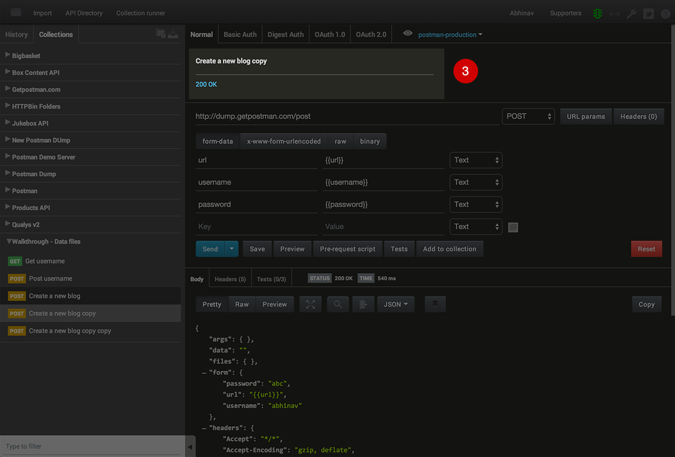
Organize using collections
Saving responses: Response identifiers show up as part of the description. Click to load the response.

Slide 20
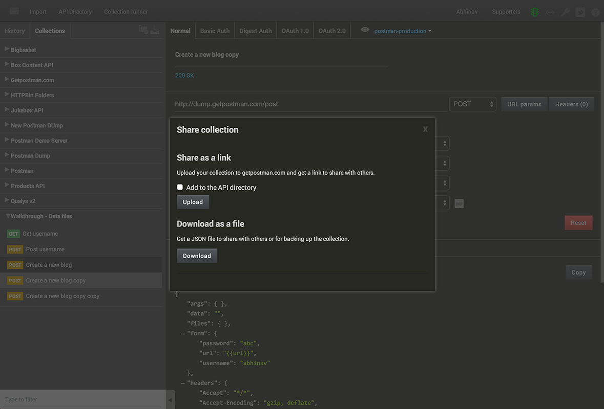
Sharing collections
Share collections with your team. On-board new developers quickly.

Slide 21
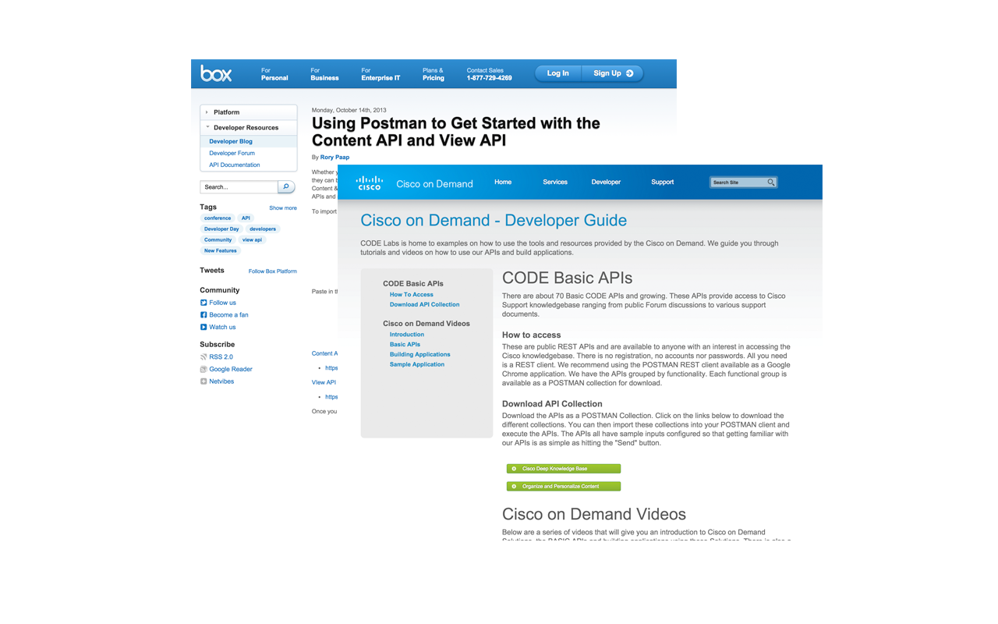
Sharing collections
Share collections through getpostman.com. Used by folks at Box, Cisco, Intel, Qualys and many more!

Slide 22
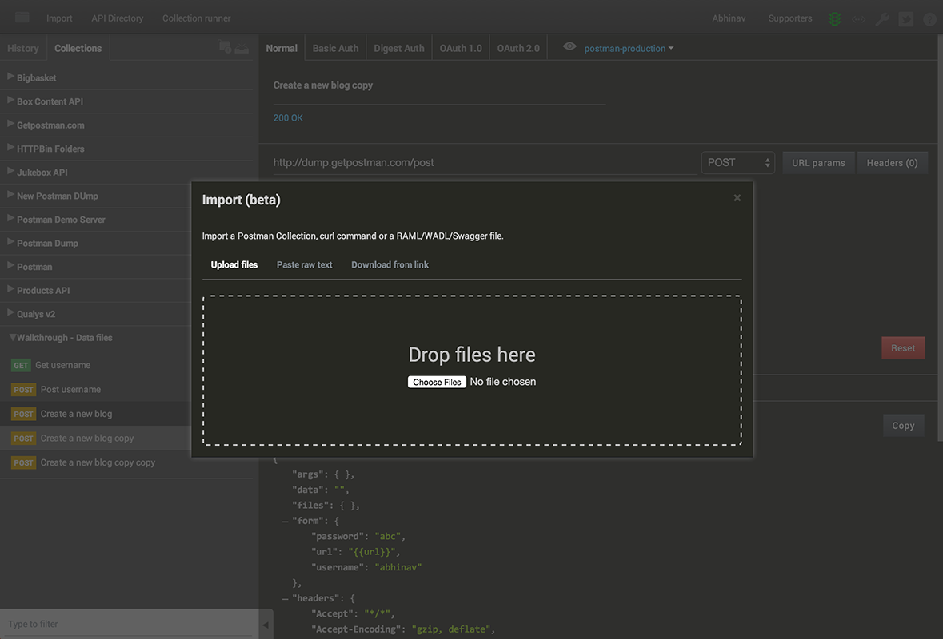
Sharing collections
Collections can be imported from the file system and URLs.

Slide 23
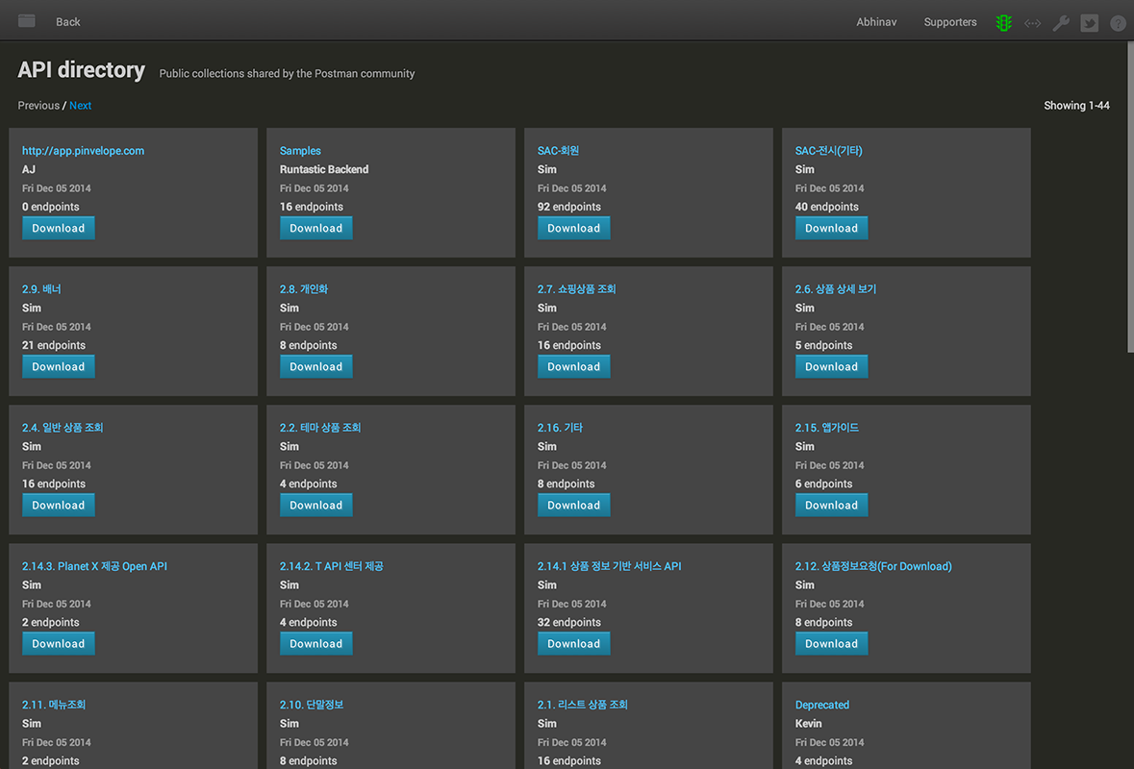
Sharing collections
Share your collections with Postman users using the API directory. Exciting updates coming soon!

Slide 24
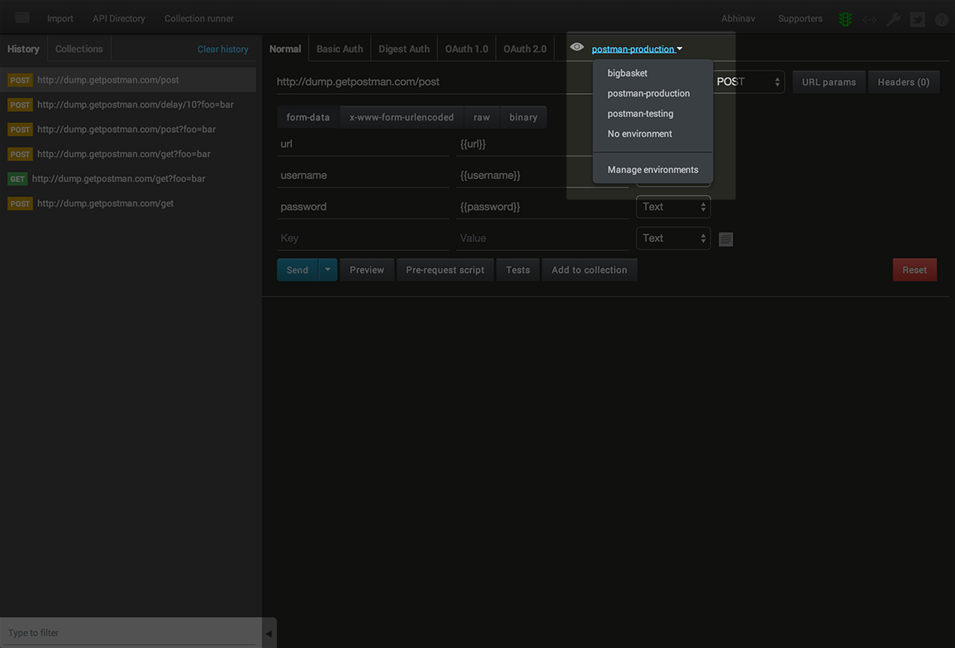
Using environments
Use variables inside requests to switch between local, staging or production environments. Can also be used to hide sensitive information while sharing collections.

Slide 25
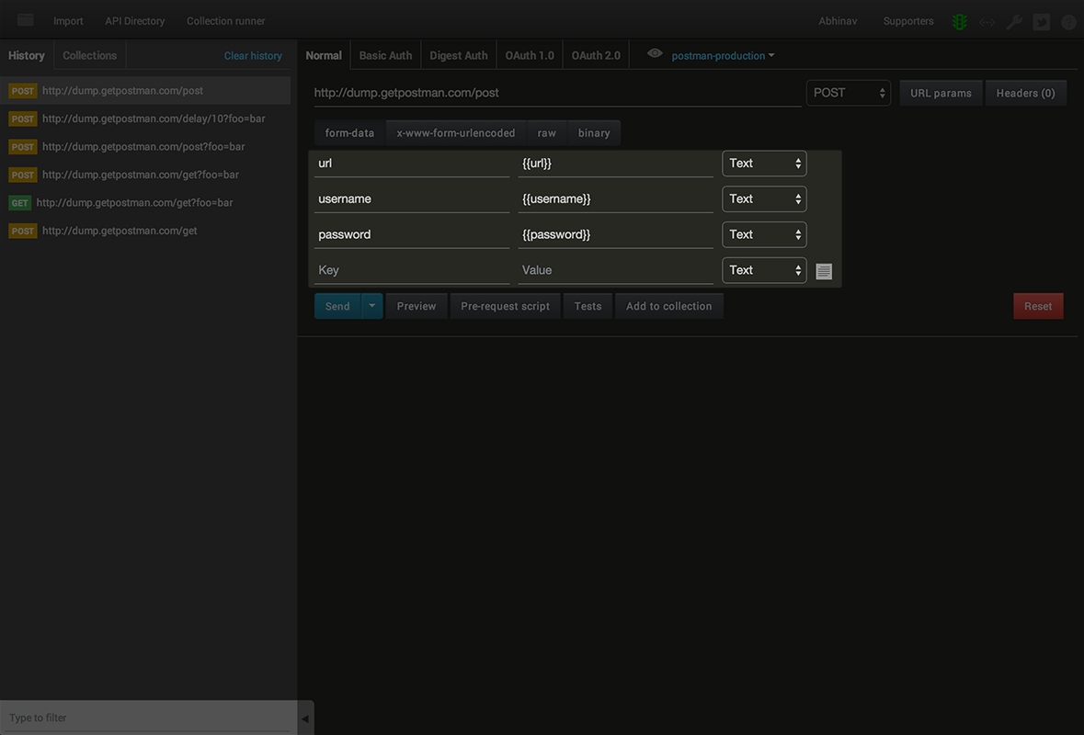
Using environments
Environment variables are enclosed in {{double curly braces}} and can be used anywhere inside request values.

Slide 26
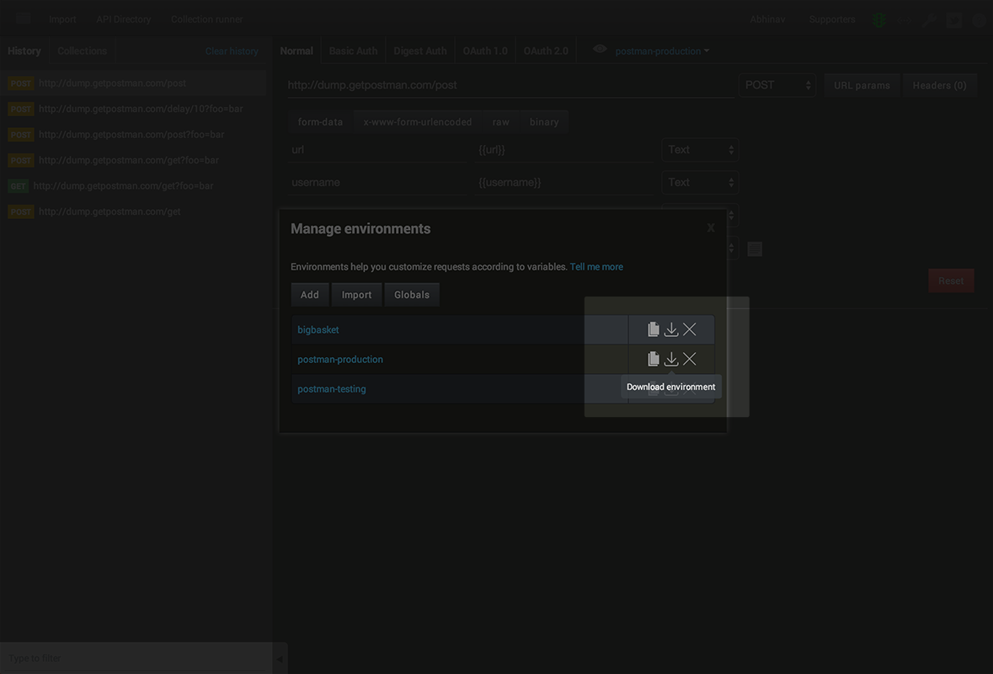
Using environments
Environments can be exported and shared.

Slide 27
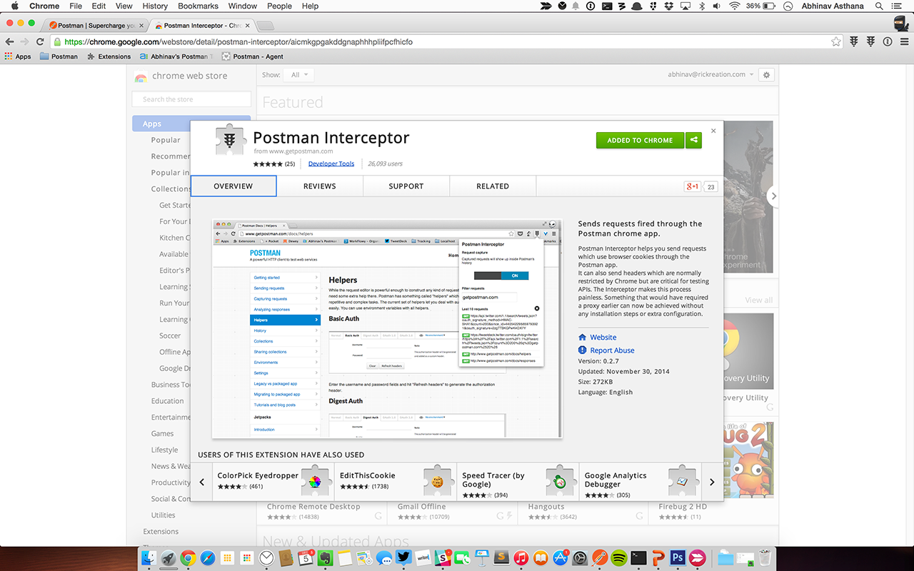
Postman Interceptor
Install the Postman Interceptor for tighter integration with the Chrome browser. Install Interceptor

Slide 28
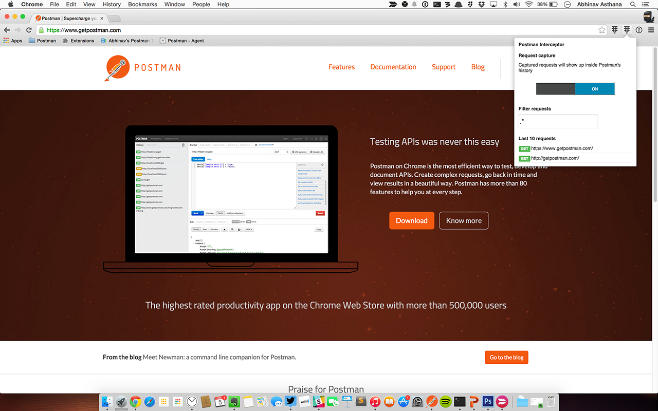
Postman Interceptor
Capture requests from a web page and stream them inside Postman’s history.

Slide 29
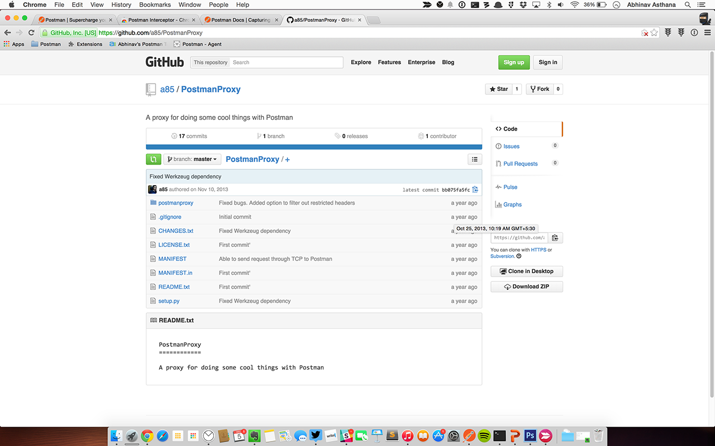
Postman Proxy
Use the Postman Proxy to capture requests from desktop applications or mobile applications. Link: https://github.com/a85/PostmanProxy

Slide 30

Jetpacks
Get the Jetpacks upgrade for writing tests, running pre-request scripts and the Collection Runner. It’s just $9.99 for a single user! Buy Jetpacks

Slide 31
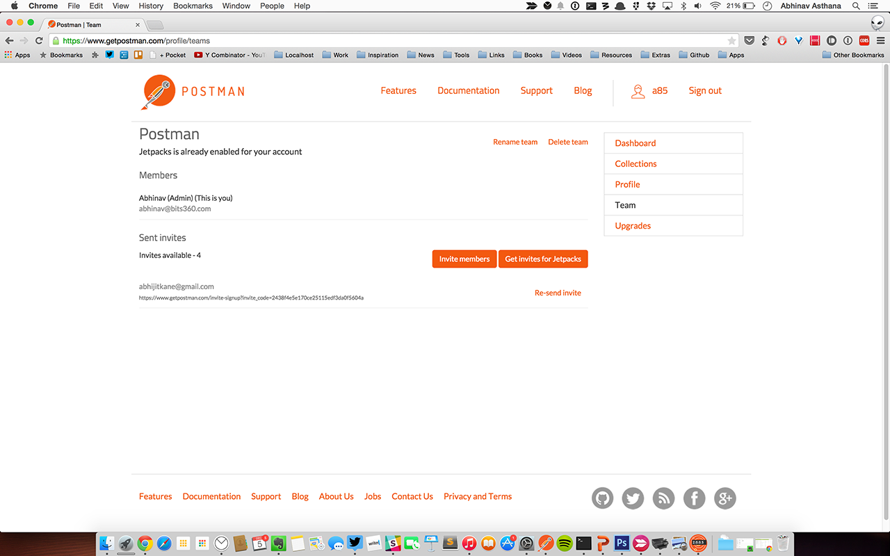
Jetpacks
Provision licenses for your entire team using the online interface. Link: https://www.getpostman.com/profile/teams

Slide 32
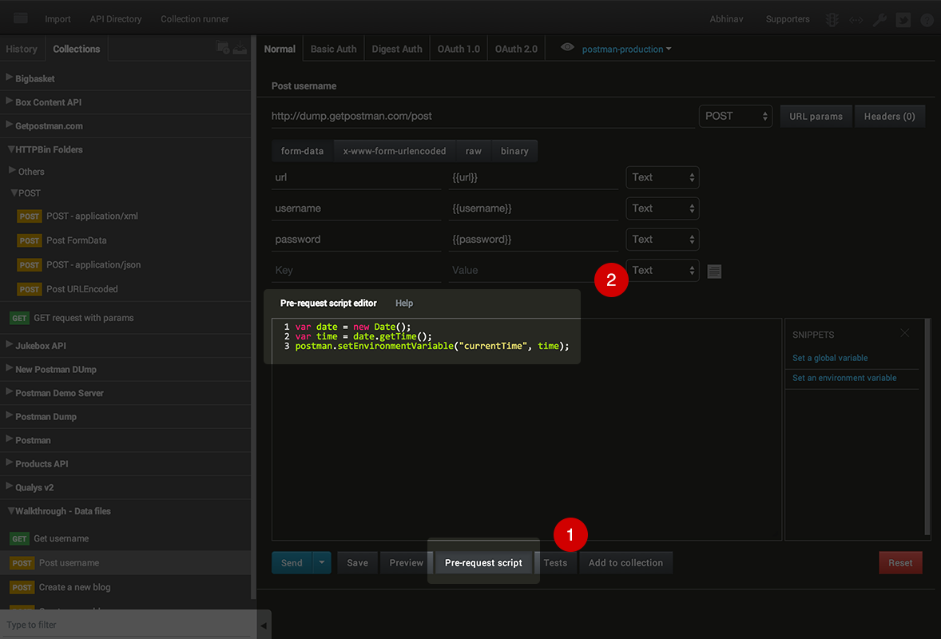
Pre-request scripts
Execute Javascript code before a request is sent. Example: Generate random numbers or timestamps and insert in requests

Slide 33
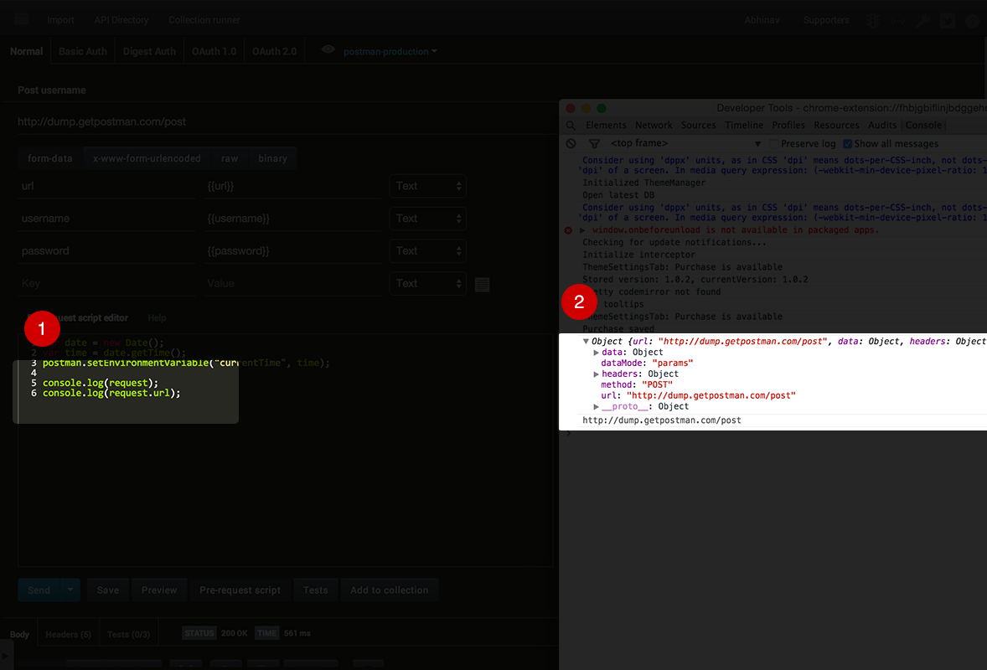
Pre-request scripts
The request object is available inside pre-request scripts. Access values from the UI and then modify them again.

Slide 34
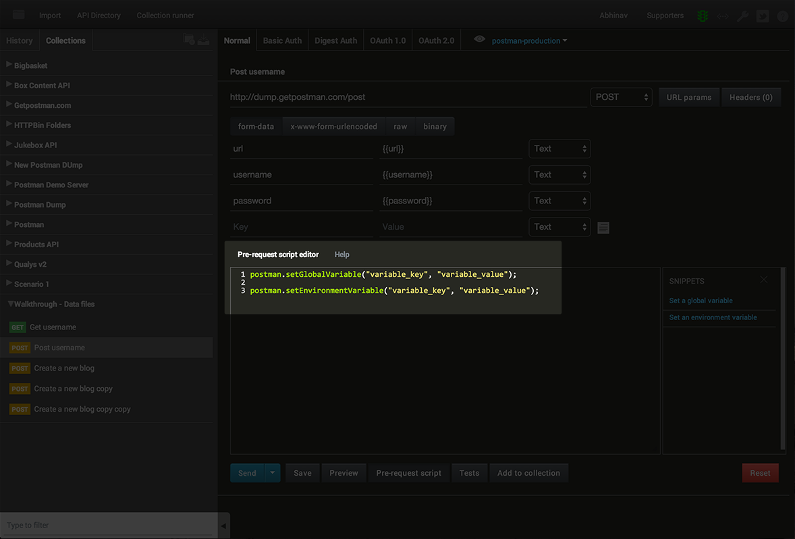
Pre-request scripts
Set environment and global variable values. Useful in request chaining.

Slide 35
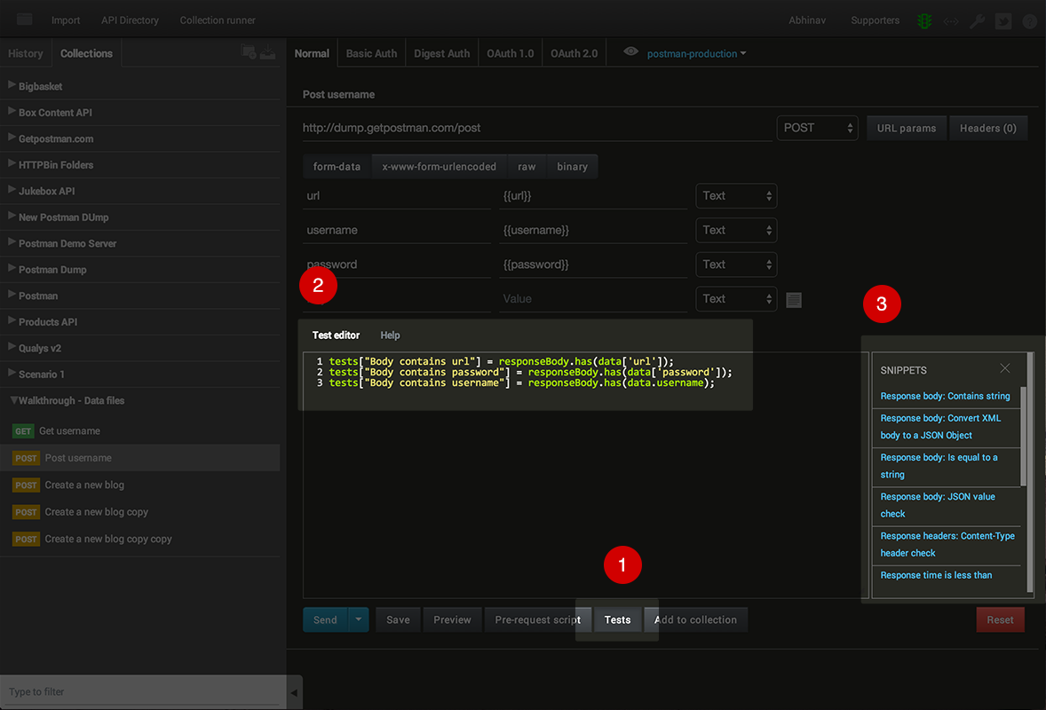
Test scripts
Write tests within Postman using the full power of Javascript. Use snippets to quickly build a test suite.

Slide 36
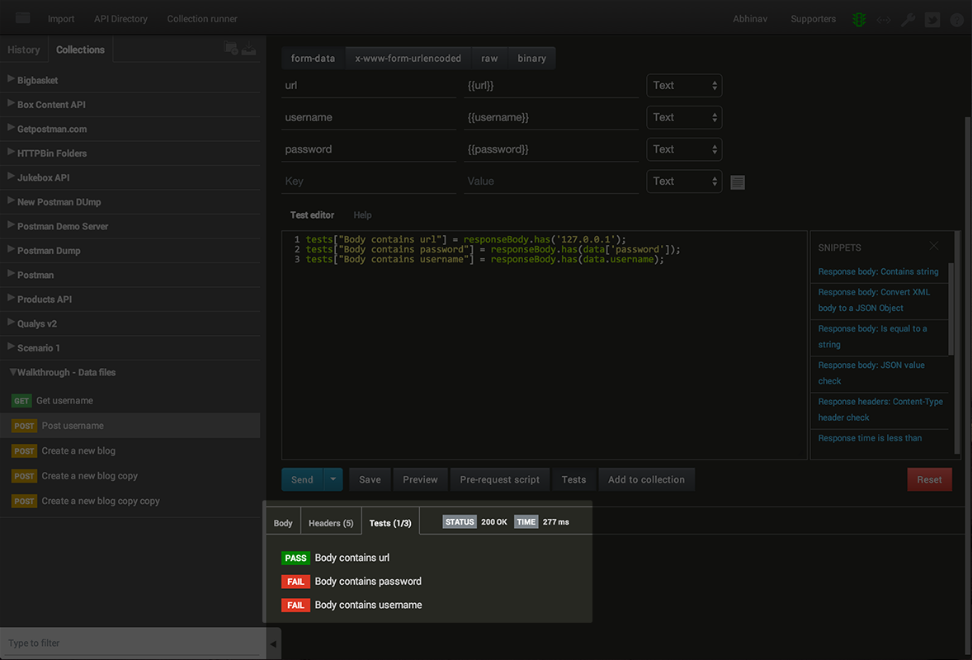
Test scripts
Results show up inside Postman with pass/fail counts. Test scripts are part of collections. Sharing a collection also shares your tests.

Slide 37
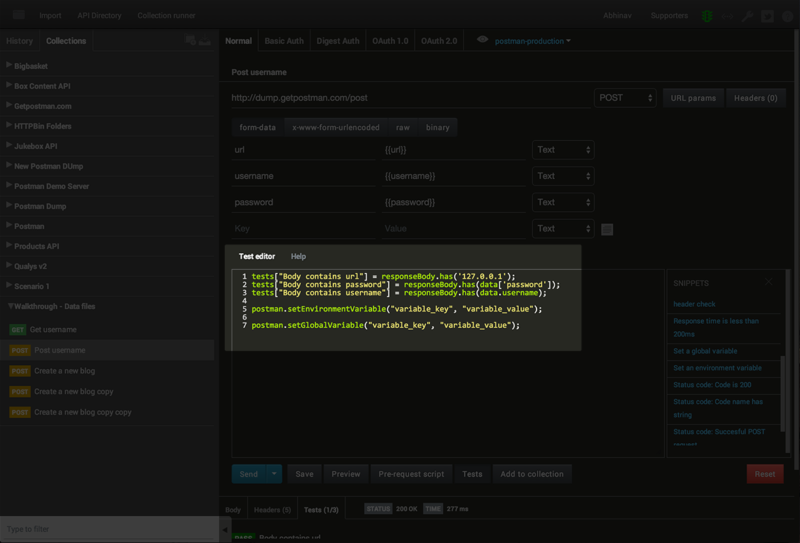
Test scripts
Environments and global values can be set inside test scripts too.

Slide 38
Request evaluation life-cycle
Gather data from the Postman UI
Pre-request scripts
Send request
Receive response
Run test scripts
Display response and test results

Slide 39
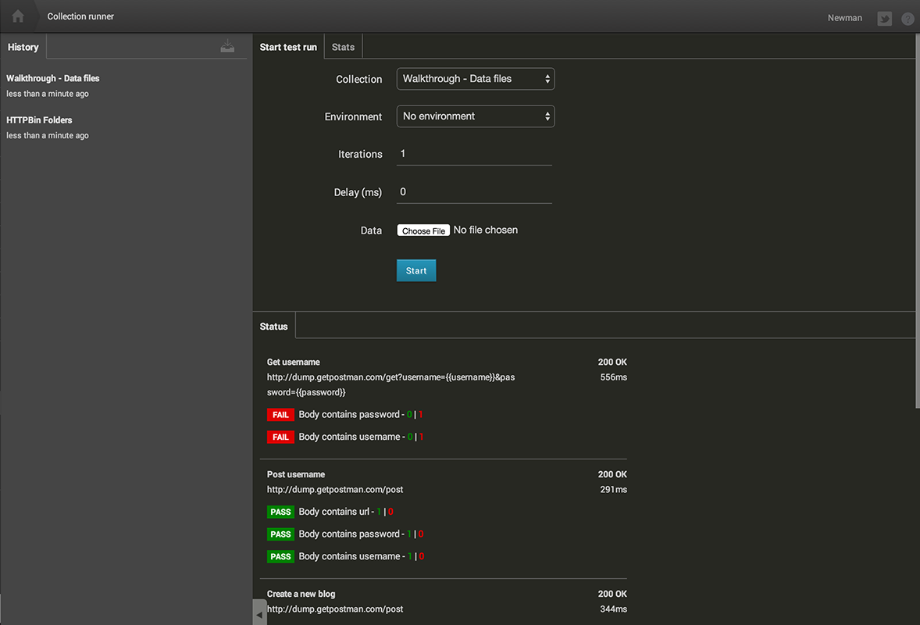
Collection runner
Run all requests in a collection or a folder together. You can run multiple iterations too.

Slide 40
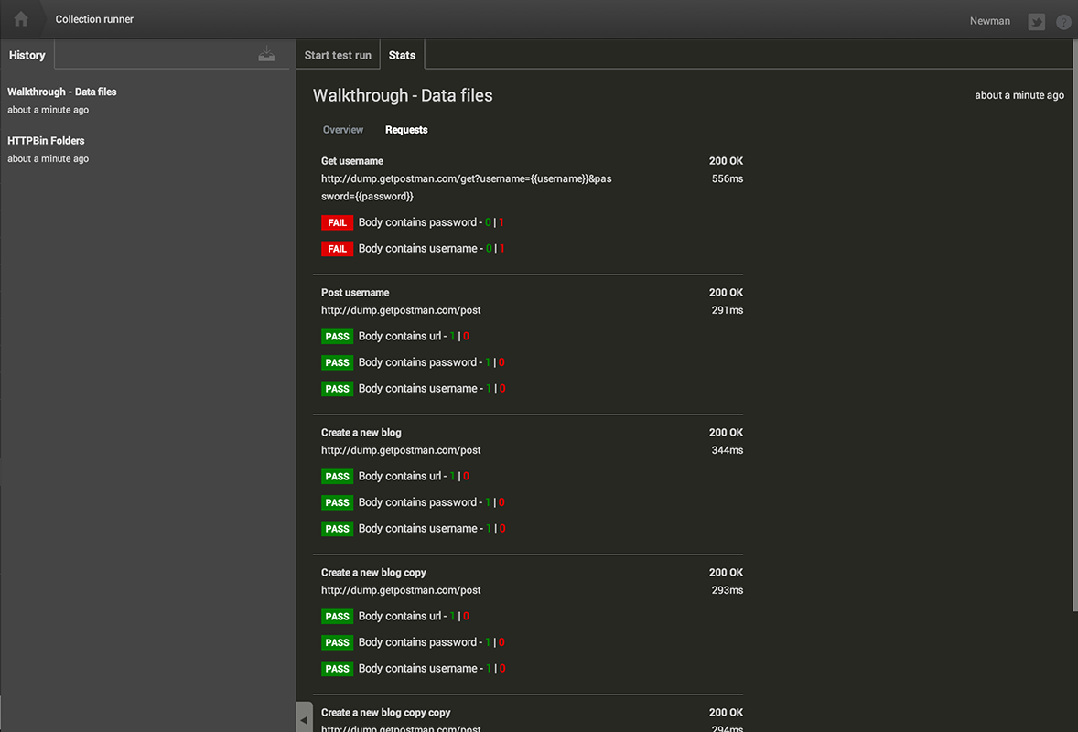
Collection runner
See aggregate test results. For multiple iterations, drill into each iteration’s result.

Slide 41
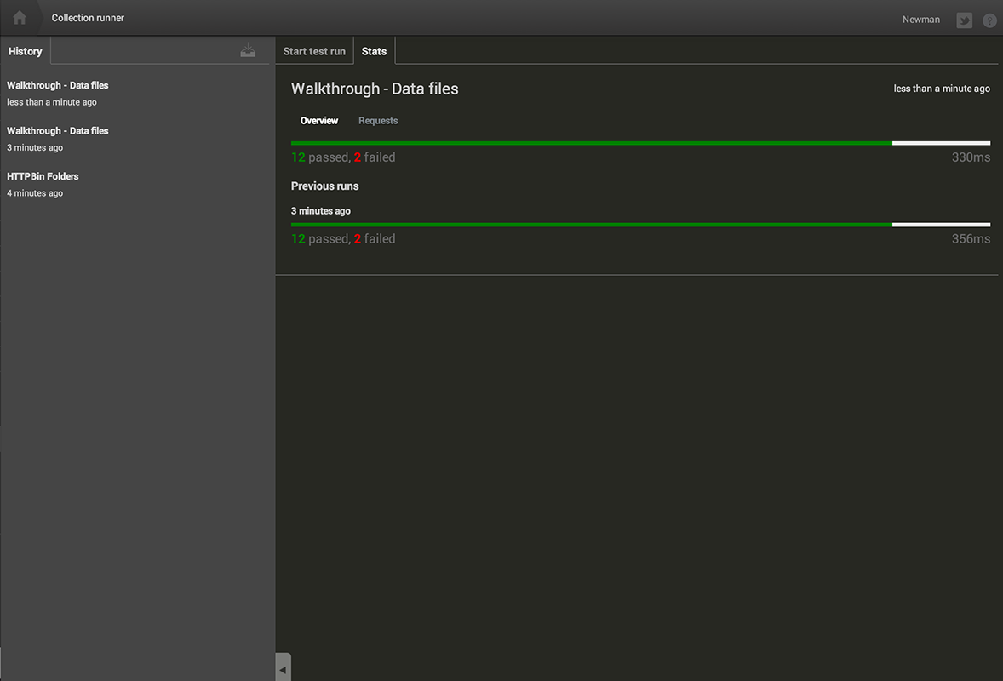
Collection runner
See previous runs. Ensure that your API tests are improving over time.

Slide 42
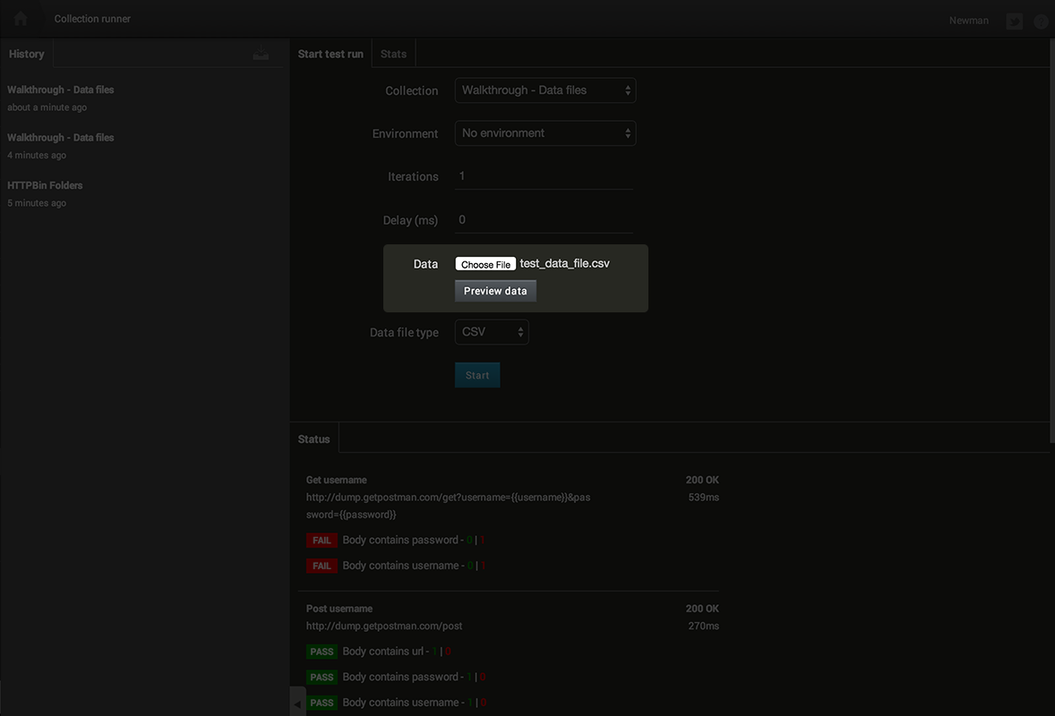
Data files
Load data files for multiple iterations. Postman supports CSV and JSON files.

Slide 43
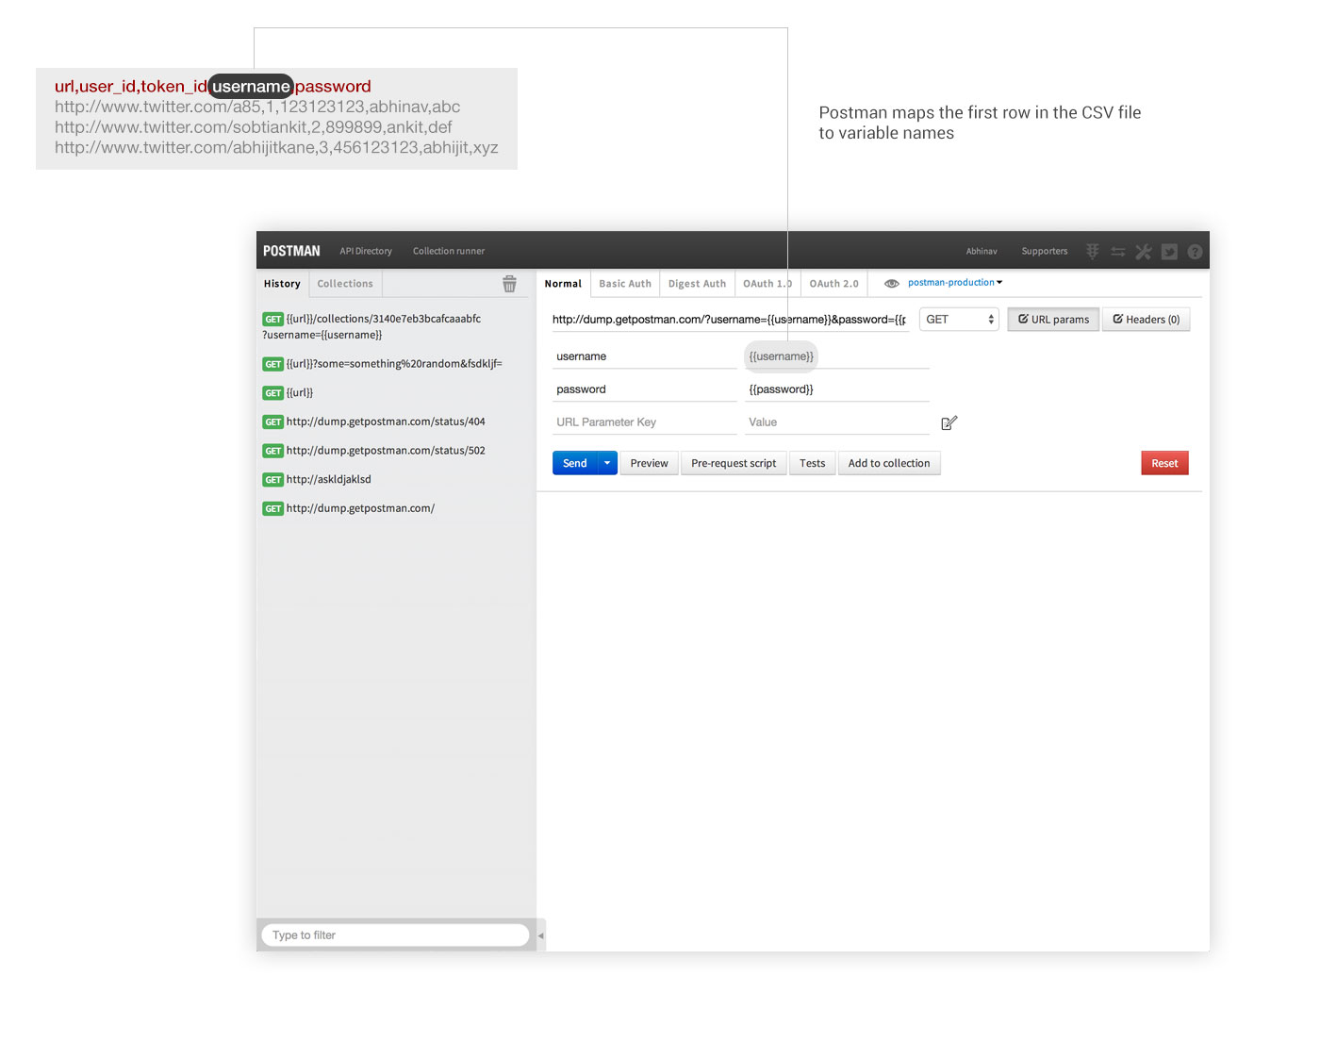
Data files
Data variables are enclosed within {{double curly braces}} in the request.

Slide 44
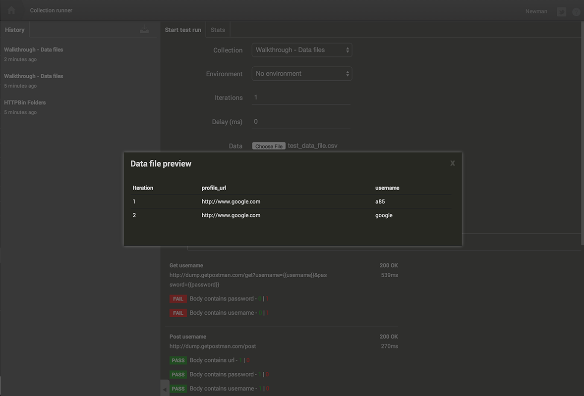
Data files
Data values are available in pre-request scripts and test scripts too using the special data variable.

Slide 45

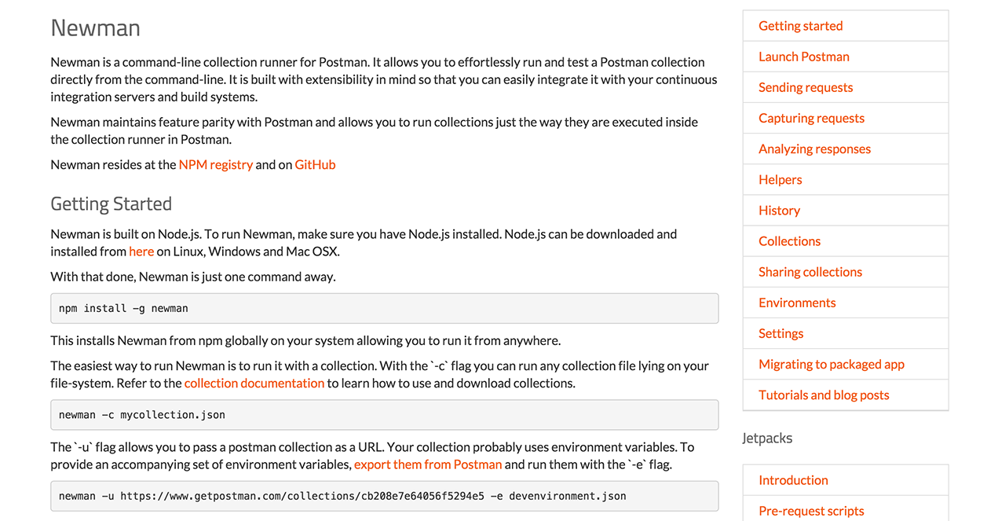
Newman
Newman is a Node.js based command line companion tool to run Postman collections. See documentation

Slide 46


Newman
+
cron/curl
Use Newman to schedule tests using cron. Integrate Newman with build systems.

Slide 47
Links
Postman (www.getpostman.com)
Postman Docs (www.getpostman.com/docs)
Postman Blog (http://blog.getpostman.com)
Postman on Twitter (https://www.twitter.com/postmanclient)
Postman on Facebook (https://www.facebook.com/getpostman)
Email us at help@getpostman.com

